Slide 1
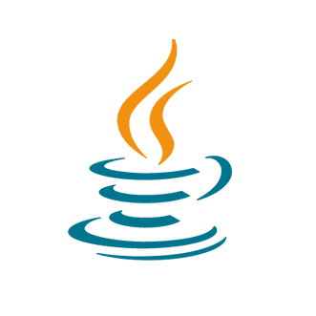
Tutorial 8: Recursion & Binary Files
COMP 249 CCCE
Object-Oriented Programming II

Slide 2
Tasks
Recursion
Binary Files

Slide 3
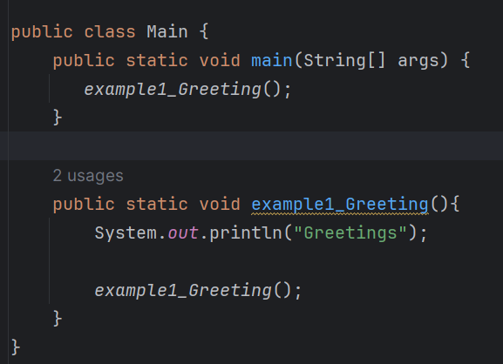

Recursion
When you have a method that calls itself (inside the method body)
Method definition that includes a call to itself is said to be recursive
Issue of infinite recursion that leads to Stack Overflow Error (like infinite while loop)
Way to break down complex problems, repetitive or hierarchical problems (divide-and-conquer algorithms, searching a list)
Example:

Slide 4
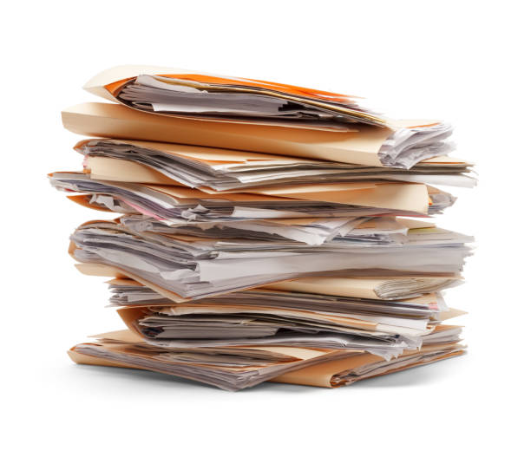















Recursion: Call Stack
When program encounters a recursive call, it temporarily stops its computation, because it must know the result of the recursive call before it can proceed
Stack is data structure (LIFO), memory structure that keeps track of recursive methods calls, local variables etc.
Stack may grow and shrink
Stack has limit
https://media.istockphoto.com/id/897711146/photo/files-stacked.jpg?s=612x612&w=0&k=20&c=lSCrKz68977MrhRUvN6vXm5LaBO0yu2aqyP9x4oc1pU=

Slide 5
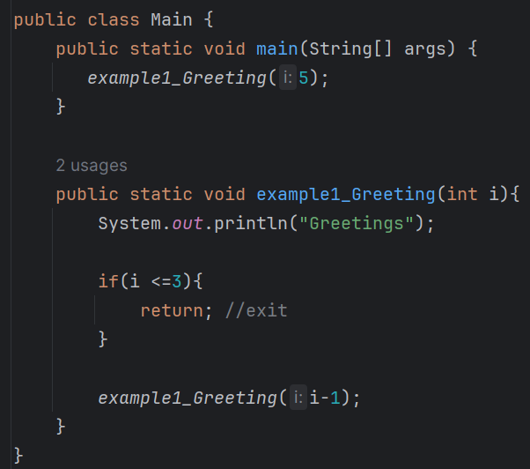
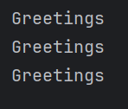
Recursion: Exit
You need a condition to safely exit the recursive method w/o causing it to run infinitely (stack overflow)
This is a job of the base case or stopping case where method accomplishes its task w/o making a recursive call
Example:
*Code example: Tutorial8_Recursion

Slide 6
Recursion: Factorial Example
Factorial of N (N!) is the product of all the numbers between 1 and N
N! = N*(N-1)*(N-2)*(N-3)*… 2*1
Why use recursive method?
Subtask 1 is a smaller version of the original task, so we can implement this subtask with a recursive call
In the code example we have:
Base case which exits the method when N is equal to 1
When making a recursive call, we pass argument (N-1) (recursive subtask*)
*Code example: Tutorial8_Recursion

Slide 7
Recursion: Fibonacci Example
Fibonacci sequence is a series of numbers where each number is the sum of the two preceding ones, usually starting with 0 and 1
For example: 0, 1, 1, 2, 3, 5, 8, 13, 21, 34, ...
Our solution:
Our program should return Nth number in Fibonacci sequence starting from 0 and list all the numbers that come before
Base case: using if statement, return the method when N <= 1
*Code example: Tutorial8_Recursion

Slide 8
Recursion Summary
Definition: In Java, a method definition may contain an invocation of the method being defined. In such cases, the method is said to be recursive.
If it should encounter a recursive call, then it temporarily stops its computation, because it must know the result of the recursive call before it can proceed
Stack Overflow if stack attempted to grow beyond its limit (infinite recursion)
Rules for successful recursive methods:
One or more cases in which the method accomplishes its task by using recursive call(s) to accomplish one or more smaller versions of the task
One or more cases in which the method accomplishes its task without the use of any recursive calls. These cases without any recursive calls are called base cases or stopping cases
Best practice: when some variable gets decreased until some set point (stopping case)

Slide 9
Recursion vs Iteration
We may use iterative version instead of recursive (loop)
Interestingly, some programming languages do not allow recursion
Pros of recursion
It is simpler
It easy for programmer to write
It makes your code easy to understand
Cons of recursion
It is usually slower because the program
It uses more storage than iterative method

Slide 10
Binary Files
Binary files store data in the same format that is used in the computer’s memory to store the values of variables.
For example, a value of type int is stored as the same sequence of bytes (same sequence of zeros and ones) whether it is stored in an int variable in memory or in a binary file.
No conversion of any kind needs to be performed when you store or retrieve a value in a binary file -> binary files can be handled more efficiently than .txt files
A binary file created by a Java program can be moved from one computer to another and still be read by a Java program
We use stream classes ObjectInputStream and ObjectOutputStream for processing binary files
They read and write methods one byte at time
They convert numbers, characters, doubles into bytes to be stored in the binary file
They can also read and write objects of classes

Slide 11
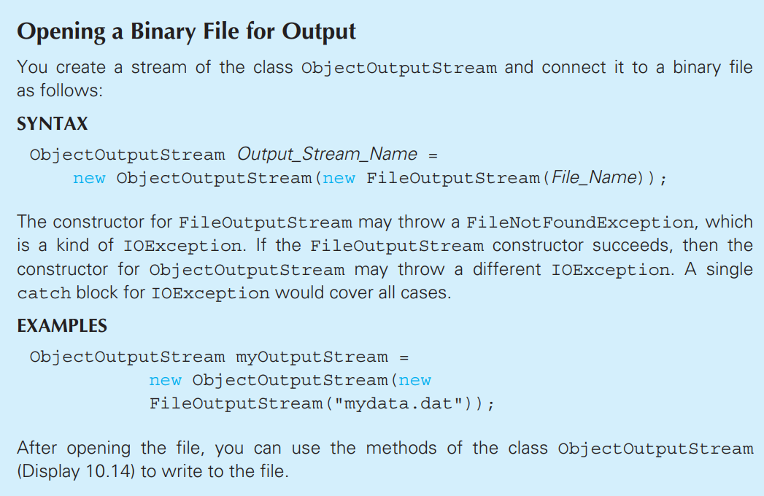
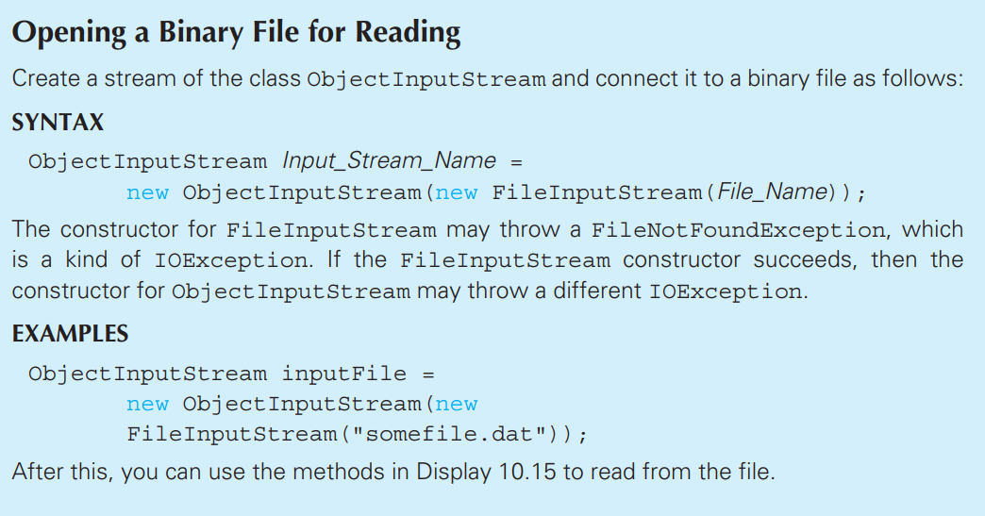


Opening Binary File for Writing & Reading
Absolute Java 6th edition
Absolute Java 6th edition
*Code Example: Tutorial8_BinaryFiles

Slide 12
Serializable
We can output objects of classes using Serializable interface
Import package java.io
We can create a class that implements Serializable interface:
public class Test implements Serializable{}
Definition: A class that implements the Serializable interface is said to be a serializable class
I/O with binary files using serializable class:
To write object of class into a binary file, we use writeObject
To read object of class from a binary file, we use readObject
*Code Example: Tutorial7_Serializable

Slide 13
References
Absolute Java 6th edition
https://www.youtube.com/watch?v=k-7jJP7QFEM&list=WL&index=9&ab_channel=CodingwithJohn
https://www.geeksforgeeks.org/recursion-in-java/

Slide 14
Have a Great Weekend!

